Slide 1
Secure Data Hiding in Images Using Steganography
EDUNET PROJECT
Presented By: Prattipati Shyam Prasad
Student Name: Prattipati Shyam Prasad
College Name & Department :
NRI Institute Of Technology, Computer Science(AIML)

Slide 2
OUTLINE
Problem Statement
Technology used
Wow factor
End users
Result
Conclusion
Git-hub Link
Future scope

Slide 3
Problem Statement
Secure communication is essential in today's digital world. This project involves creating a Python-based steganography tool that allows users to securely embed text messages within cover images.
Using a user-provided password, the tool encrypts and hides the message, producing an encrypted image named "EncryptedImage.png."
A separate decryption program will retrieve the hidden message using the correct password. This solution ensures confidential communication via image-based steganography.

Slide 4
Technology used
Programming Language:
Python - https://www.python.org/ftp/python/3.13.2/python-3.13.2-amd64.exe
Libraries:
OpenCV for image processing - pip install opencv-python
Platform: Windows
RAM - 16.00GB
System type - 64-bit operating system, x64-based processor
Tools: Visual Studio Code
Go to the official VS Code download page: https://code.visualstudio.com/download

Slide 5
Wow factors
User-Friendly Interface: Simple inputs for cover image, message, and password.
Enhanced Security: User-defined password for both encryption and decryption.
High-Quality Output: Preserves image quality with PNG format.
Versatile Decryption: Validates password to ensure authorized access.
Educational Value: Hands-on learning in steganography, cryptography, and image processing.
These features collectively enhance the functionality, security, and educational value of my project.

Slide 6
End users
Cybersecurity Professionals: Protect sensitive information by embedding it in images.
Journalists and Whistleblowers: Communicate covertly in regions with restricted freedom of speech.
Artists and Creatives: Add hidden messages or layers of meaning to their artwork.
Researchers and Academics: Develop and improve steganography techniques.
Everyday Users: Enhance privacy by hiding personal information within images.

Slide 7
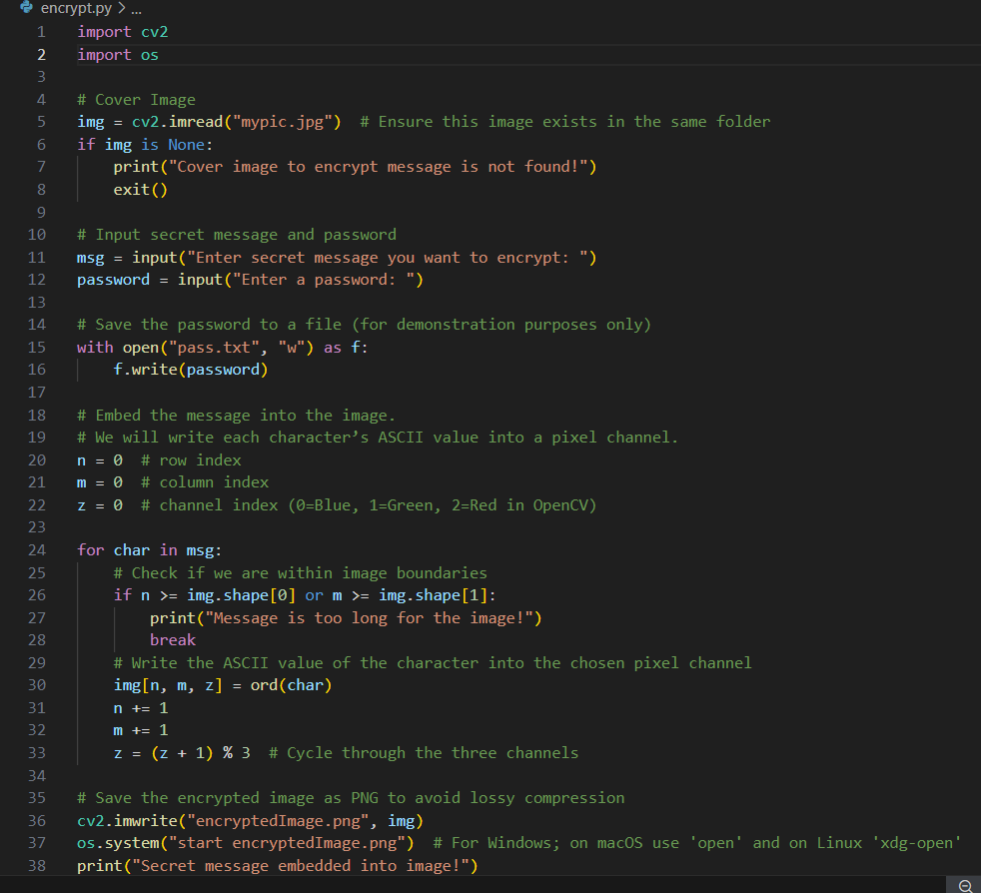
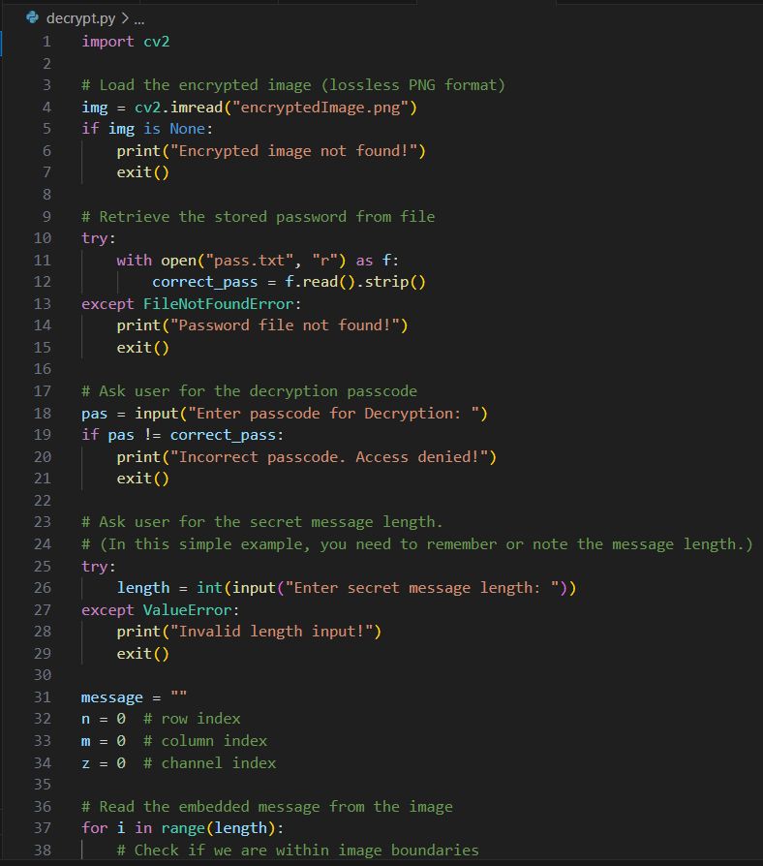
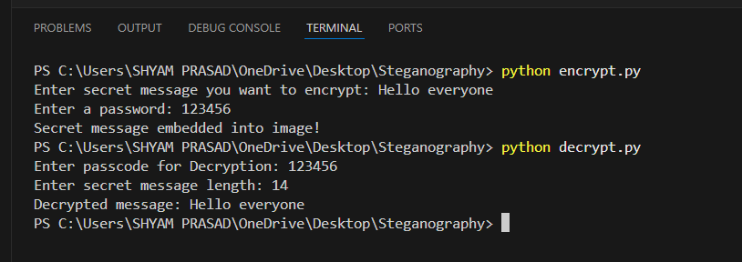

Results
Screenshots of the outcome (min

Slide 8
Conclusion
This Python-based steganography offers a secure way to embed and retrieve confidential messages within images, ensuring that only authorized individuals can access the hidden content. With user-provided passwords for encryption and decryption, the solution maintains privacy and data protection. The tool generates an output image ("EncryptedImage.png") that retains the visual integrity of the original, making it a reliable method for secure communication through image-based steganography.

Slide 9
GitHub Link
https://github.com/Shyam5824/Secure-Data-Hiding-In-Images-Using-Steganography.git

Slide 10
Future scope
Enhanced Security: Development of more sophisticated techniques to counter evolving cyber threats.
AI and Machine Learning Integration: Using AI/ML to create advanced steganographic methods, improving undetectability.
Improved Algorithms: Continuous enhancement of algorithms to increase data capacity and robustness.
Wider Applications: Expansion into fields like digital watermarking, secure communication, and data integrity verification.
Real-Time Steganography: Techniques for secure communication in live video streams and real-time data transmission.
Quantum Steganography: Potential use of quantum computing for unprecedented security levels.
Legal and Ethical Frameworks: Establishing guidelines to govern the use and prevent misuse of steganography.

Slide 11
THANK YOU

